Slide 1
Review of AGI
Changyu.Zeng
2021.8.31

Slide 2
Outline
History
Definition
NARS
Reward is enough
Reinforcement learning

Slide 3
History
1950 Turing
1956-1974
Golden age
1956
Dartmounth
Conference
1981-now
Machine learning and its application
1974-1980
Cold winter

Slide 4
Problem
Contemporary AI is mostly designed for specific tasks.
High efficiency but low versatility.
Good at information perceptron and machine learning, but poor at conceptual abstraction and reasoning decision
No a system to integrate AI in various fields

Slide 5
Definition
Artificial General Intelligent(AGI) refers to a machine has the same intelligence and perform all the intelligent behaviors as human.
Connect AI with consciousness, sensibility, knowledge.
General intelligent feature
Comprehensive intelligent
Humanoid
Intelligent theory
Formative model
Computer realization
feature
A complete AGI including

Slide 6
Different fields
Structure school
Background: neuroscience, neural network
Limitation: impossible and no necessary to copy the physiological details
Behavior school
background: psychology and linguistics
limitation: too much psychology and social elements to repeat
Ability school
background: computer science
limitation: definition of intelligent and hard to combine the fragmented AI technologies in different fields.
Principle school
Background: mathematic and logic
Limitation: too much elements to affect so that no single theory can explain or generalize

Slide 7
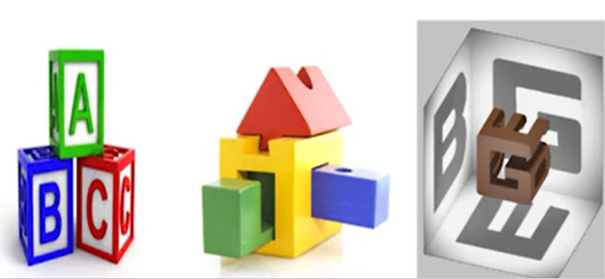
Strategy and Technology
Mix strategy
Method: Apply various theories to realize separate function then connect them
Limitation: Compatibility of different technologies
Integrated strategy
Method: First design a system, then use different technology to realize various functions.
Limitation: standardization and cooperation
United strategy
Using one technology start from core and expand
Limitation: core technology versatility and scalability

Slide 8
Non-Axiomatic Reasoning System(NARS)
Definition
A project aimed at the building of a general purpose intelligent system, or a “thinking machine” that follows the same principle as the human.
Design
Based on intelligent under insufficient resources environment
Take unified approach or single core technique
Build in the framework of reasoning system, with multi-layers
Systems belief is the summaries of experience

Slide 9
NARS Structure
Language and Logic
Use multi-layers to build solid sematic foundation with inheritance logic, which describe how rules formed, relations between terms.
Control and Implementation
Input sentence is a task to process. Belief (knowledge summarized from previous experience) solves question and goals. These two are clustered into concept.

Slide 10
Reward is enough
Hypothesis
Intelligent can be understood as subserving the maximization of reward. Accordingly, reward is enough to drive behavior that exhibits abilities studied in natural and AI.
Agent can learn through trial and error experience to maximize reward.
Reinforcement learning agents could constitute a solution to AGI.

Slide 11
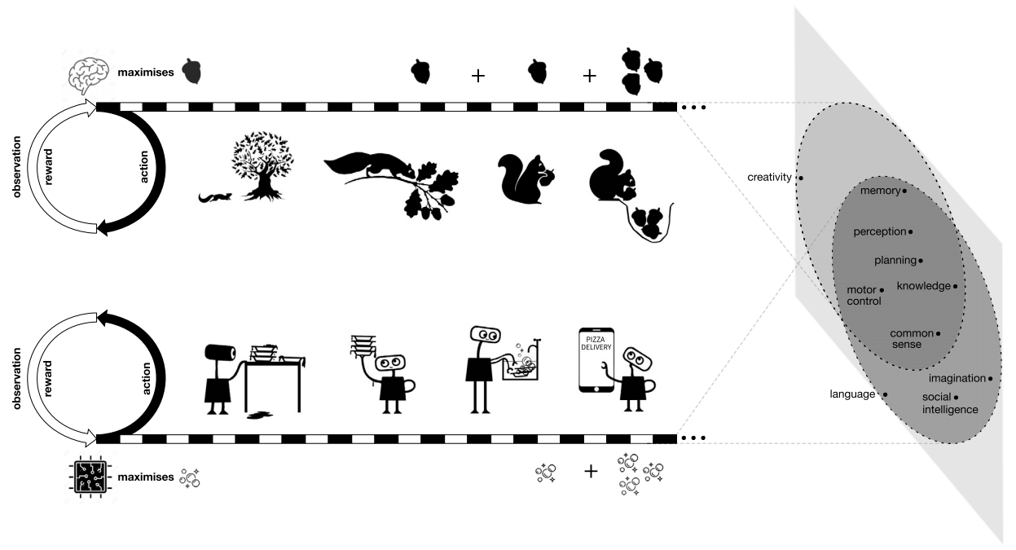
Example
Single goal
Complex behavior
Multiple ability

Slide 12
Reinforcement Learning(RL)
Definition
RL describe and solve the problem of the agent in the process of interacting with the environment through learning strategies to maximize returns or achieve specific goals.
Interact with environment to receive feedback
Direct how to make a decision
Object is to maximize the return
AlphaGo - Game
AWS DeepRacer - Auto-drive
Deepmind- Google data manage
Features
Applications

Slide 13
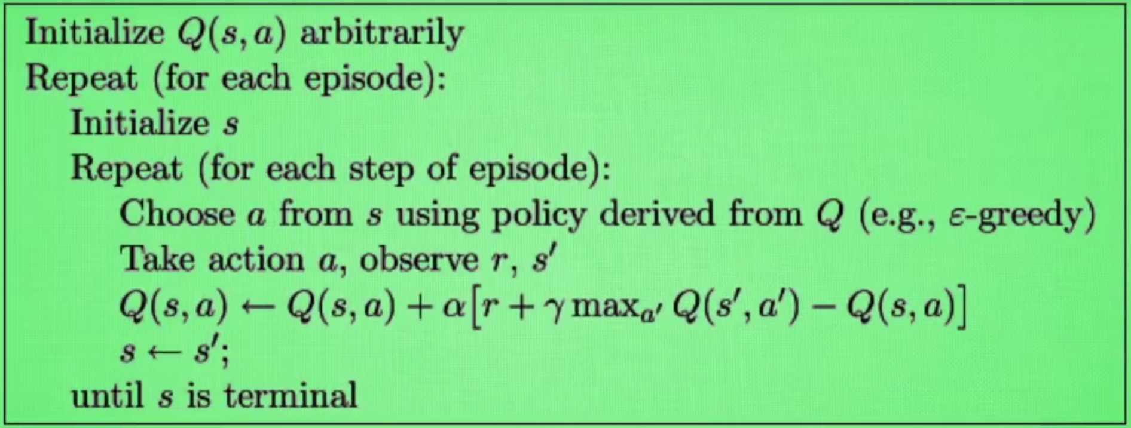
Q-Learning
Record learning history to construct Q-table. Then it will direct agent what action to take under what circumstances will have the greatest reward value.

Slide 14
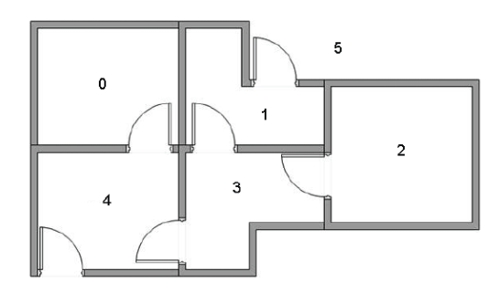
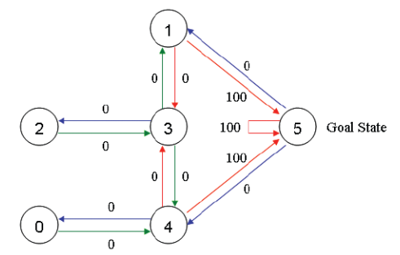
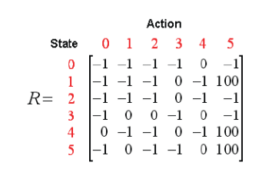
Example

Slide 15
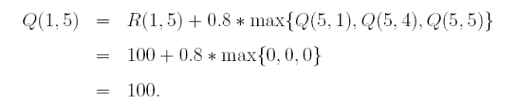
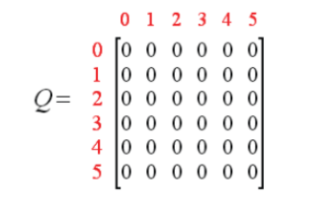

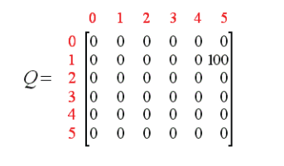
Example

Slide 16
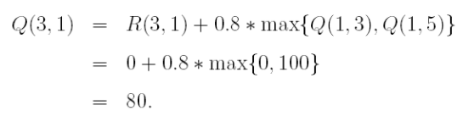
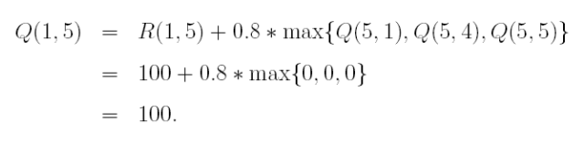
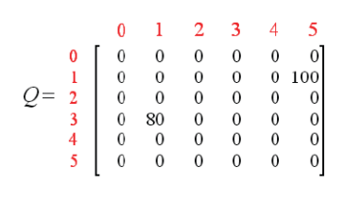
Example

Slide 17
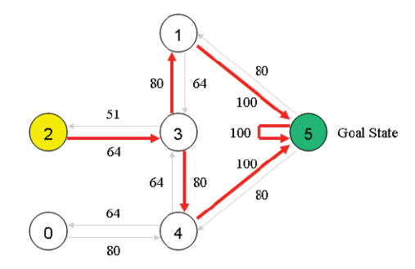
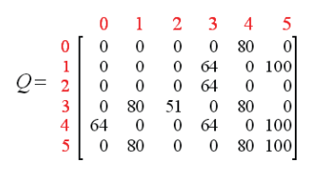
Example

Slide 18
Thanks

